Slide 1

Text Summarization
Presented by: Presented To:
Piyush Prakhar (S25MCAG0109) Dr. Supriya Chanda
Ankit Kumar(S25MCAG0110) Assistant Professor
Harsh Patel (S25MCAG0121) Bennett University

Slide 2
Introduction
The exponential growth of digital text has created a need for automated, reliable summarization techniques.
Traditional extractive models preserve factual content but often lack linguistic coherence.
Transformer-based abstractive models generate fluent summaries but may diverge from the source.
A hybrid summarization framework integrates both approaches to achieve balanced performance.
This system employs LexRank for extractive sentence selection and BART for abstractive refinement.
The resulting summaries aim to maintain factual accuracy while enhancing readability.
Evaluation through ROUGE metrics ensures objective measurement of summarization quality.
1
Notes:
Image source: https://wikidocs.net

Slide 3
Technology Used
Frontend:
Streamlit
  Provides a lightweight and interactive web interface.
  Supports fast prototyping without complex HTML/CSS/JS.
Python UI Components
  Streamlit widgets such as text areas, buttons, dropdowns, and data tables.
    Allows real-time text input, summary display, and evaluation metric visualization.
Ensures a simple, user-friendly summarization dashboard.
2
Notes:
Image source: https://wikidocs.net

Slide 4
Technology Used
Backend:
Python
  Core programming language powering the entire summarization pipeline.
NLTK (Natural Language Toolkit)
  Used for tokenization, sentence splitting, stopword removal, and lemmatization.
LexRank (Extractive Summarization)
  Graph-based algorithm that ranks and selects important sentences.
BART (Abstractive Summarization)
  Transformer-based sequence-to-sequence model from HuggingFace.
  Generates a more natural, fluent, and concise summary.
ROUGE Score Module
  Calculates precision, recall, and F1 metrics to evaluate summary quality.
  Produces the initial extractive summary.
3
Notes:
Image source: https://wikidocs.net

Slide 5
Types of Text Summarization techniques
There are two primary types of text summarization techniques:
Extractive Summarization: Automatically generates summaries by selecting and combining key passages from the original text. Unlike human summarizers, these models focus on extracting the most important sentences without creating new content.
Abstractive Summarization: generates entirely new sentences to convey key ideas from the original text. abstractive methods rephrase information in a more concise and coherent manner, often using new vocabulary that wasn't present in the original.
4
Notes:
Image source: https://wikidocs.net

Slide 6
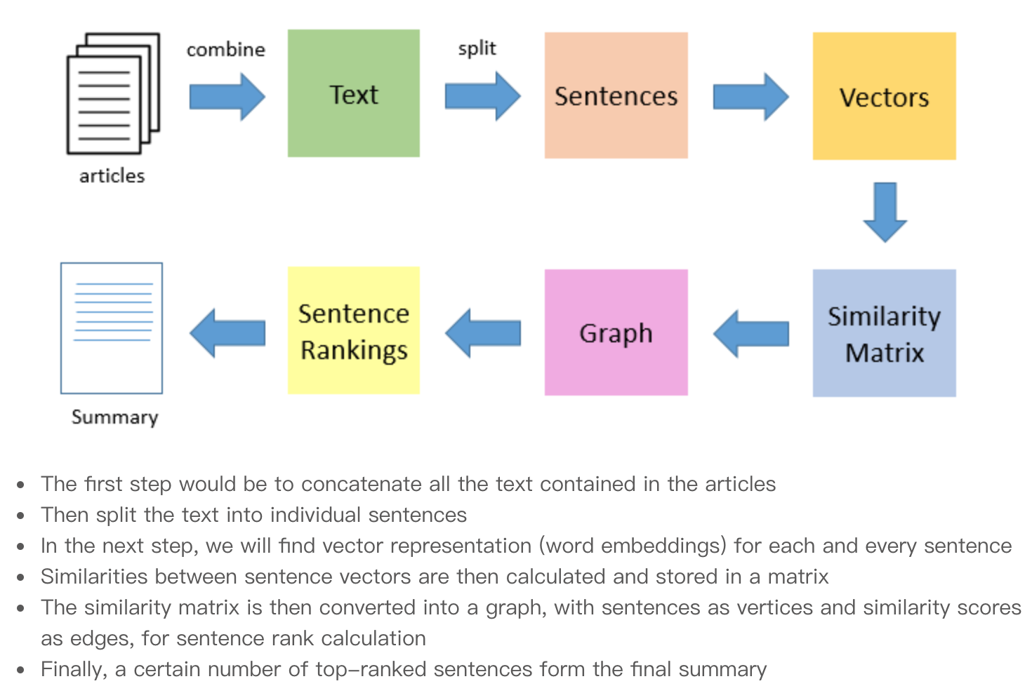
Extractive Summarization Methods
Identifies the most informative sentences directly from the input text.
Uses LexRank, a graph-based centrality algorithm similar to PageRank.
Builds a similarity graph where each node is equal to a sentence.
Computes cosine similarity between sentences using bag-of-words.
Ranks sentences by importance using eigenvector centrality.
Selects top 4 sentences as the extractive summary.
Ensures strong factual grounding because text is taken from original source.
4
Notes:
Image source: https://licor.me

Slide 7
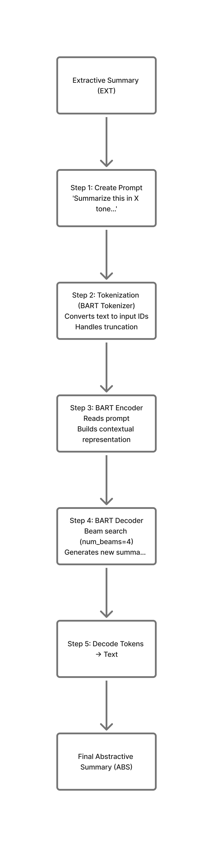
Abstractive Summarization Methods
Uses BART-Large-CNN, a transformer-based encoder–decoder model.
Takes extractive summary (LexRank output) as input.
Encodes input into latent representation using BART encoder.
Generates new sentences using deep learning.
Decoder generates new summary using beam search (num_beams=4).
Produces smoother, human-like, tone-controlled summaries.
Ensures readability, coherence, and natural language flow.
5
Notes:
Image source: https://dfzljdn9uc3pi.cloudfront.net

Slide 8
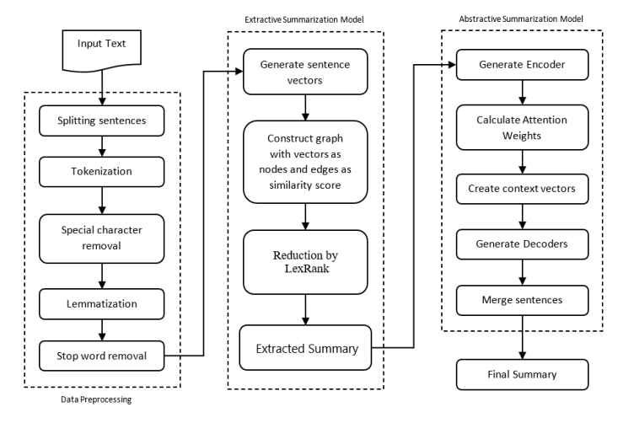
Workflow
Create BART Prompt
Tokenization Using BART
BART Encoder
BART Decoder
Decode Tokens to Text
6
Notes:
Image source: https://data-flair.training

Slide 9
Data Preprocessing
The input text is first divided into individual sentences.
Special characters and punctuation are removed to reduce noise.
Lemmatization transforms words to their base form (e.g., “running” → “run”).
Each sentence is tokenized into words for easier processing.
Stopwords (e.g., “the”, “and”, “is”) are removed to retain only meaningful content.
Output: A cleaned set of sentences ready for extractive analysis.
7
Notes:
Image source: https://blogs.mathworks.com

Slide 10
Extractive Summarization
Preprocessed sentences are converted into numerical vectors representing semantic meaning.
A similarity graph is constructed where:
  Each sentence acts as a node.
  Edges represent similarity scores between sentences.
LexRank, a graph-based ranking algorithm, identifies the most central and informative sentences.
The top-ranked sentences are selected to form the Extracted Summary.
Output: A concise extractive summary that captures the core ideas.
8
Notes:
Image source: https://www.slidemake.com

Slide 11
Abstractive Summarization
A BART prompt is created, including the extractive summary and a tone instruction (e.g., formal, neutral, news-like).
The BART encoder processes the tokens and builds contextualized representations of the text.
The BART decoder generates a rewritten, more fluent, and concise summary using beam search.
Input text is tokenized using the BART tokenizer to convert it into model-ready IDs.
Generated tokens are converted back into readable text to form the Final Abstractive Summary.
This step ensures the final output is smooth, grammatically correct, and semantically rich.
8
Notes:
Image source: https://www.slidemake.com

Slide 12
Evaluation Metrics
Metric | What It Measures | Purpose / Interpretation
ROUGE-1 | Unigram (single word) overlap | Measures keyword-level content retention in the summary
ROUGE-2 | Bigram (two-word sequence) overlap | Evaluates fluency and phrase-level coherence
ROUGE-L | Longest Common Subsequence (LCS) | Checks structural similarity, sentence flow, and readability
Precision | Relevant content / Generated content | High precision = summary is accurate and avoids irrelevant text
Recall | Relevant content / Original content | High recall = summary captures most important points
F1 Score | Balanced average of precision & recall | Indicates overall quality; balances completeness and correctness
8
Notes:
Image source: https://www.slidemake.com

Slide 13
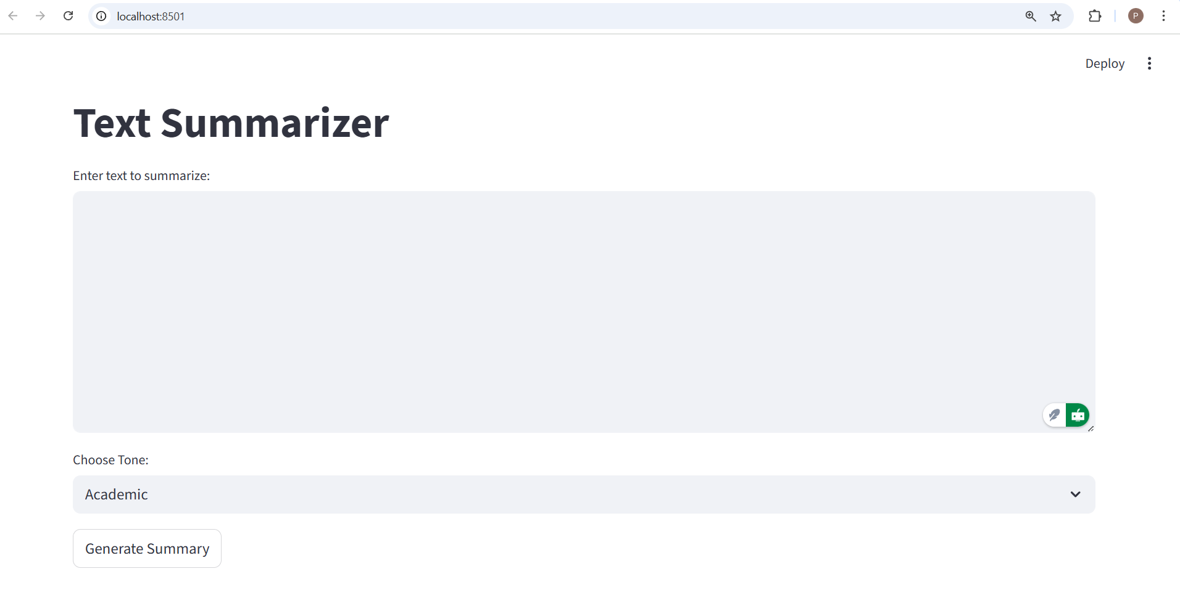
Project Screenshot
12
Notes:
Image source: https://image.slidesharecdn.com

Slide 14
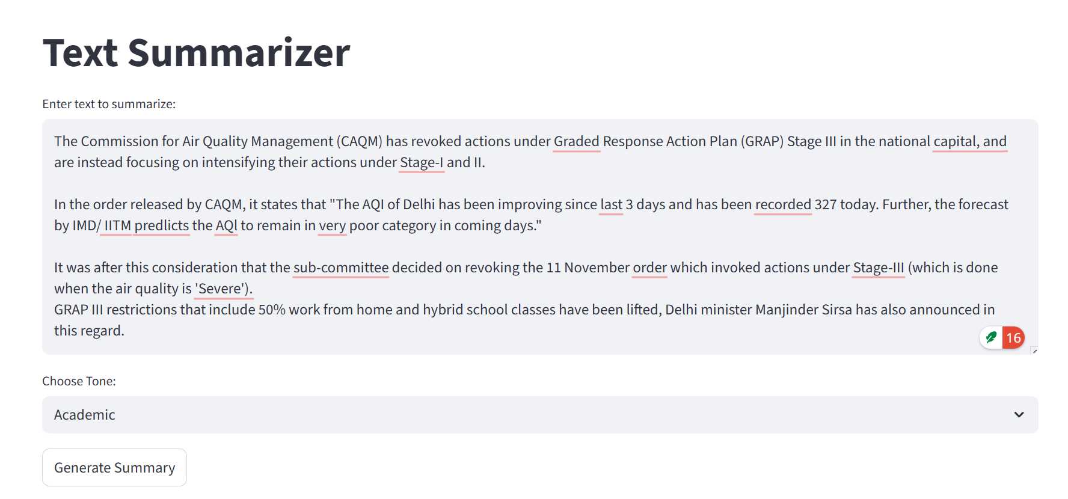
Project Screenshot
12
Notes:
Image source: https://image.slidesharecdn.com

Slide 15
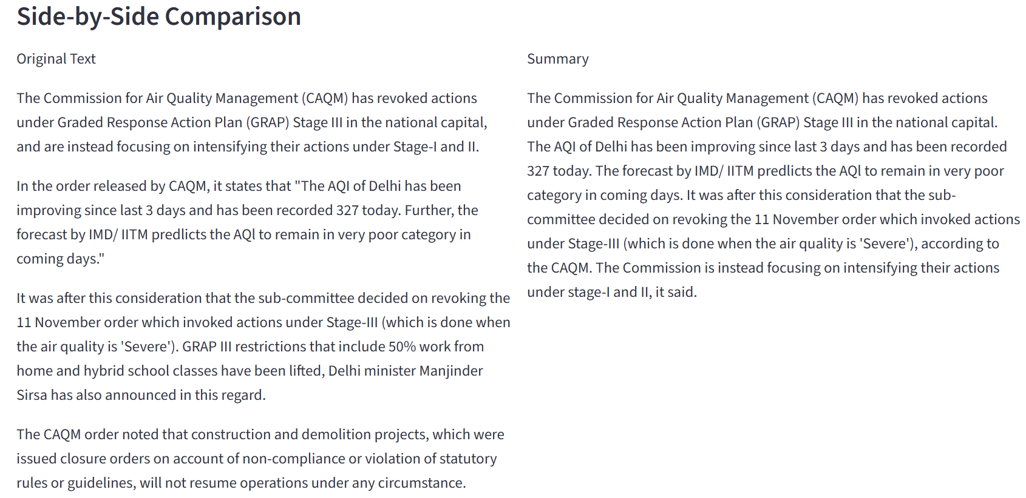
Project Screenshot
12
Notes:
Image source: https://image.slidesharecdn.com

Slide 16
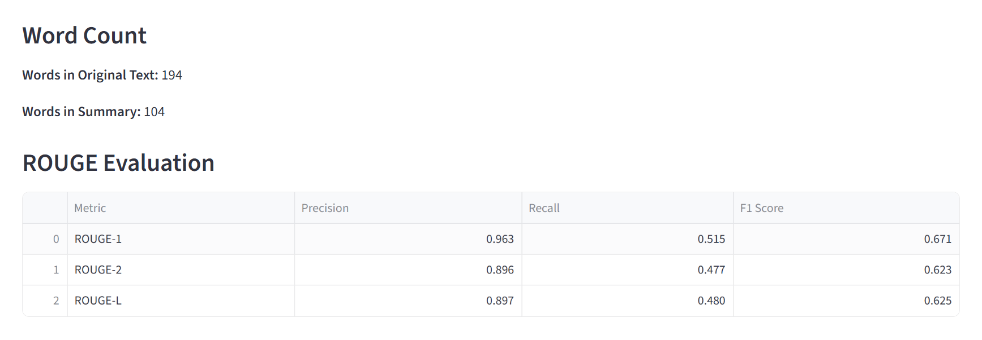
Project Screenshot
12
Notes:
Image source: https://image.slidesharecdn.com

Slide 17
ROUGE and its Metrics Evaluation
ROUGE stands for Recall-Oriented Understudy for Gisting Evaluation.
It is a popular method to evaluate how good a text summary is.
ROUGE checks how much your generated summary matches the human-written (gold) summary.
There is no single “correct answer”
Different people can summarize differently
But important points should match
ROUGE measures if your summary contains important words, phrases, and meaning from the reference summary.
13
Notes:
Image source: https://image.slidesharecdn.com

Slide 18
Why use ROUGE ?
ROUGE is used because:
Summaries can differ, but key ideas must match.
It works well for:
  Abstractive summarization
  Extractive summarization
  Machine translation evaluation (sometimes)
  Recall measures how much important content was captured by the generated summary
Recall = Overlapping Content/Content in Refrence Summary
13
Notes:
Image source: https://image.slidesharecdn.com

Slide 19
ROUGE is used because:
Summaries can differ, but key ideas must match.
It works well for:
  Abstractive summarization
  Extractive summarization
  Machine translation evaluation (sometimes)
  Recall measures how much important content was captured by the generated summary
Recall = Overlapping Content/Content in Refrence Summary
13
Notes:
Image source: https://image.slidesharecdn.com

Slide 20
Future Work
Enhance extractive accuracy by using semantic embeddings (e.g., Sentence-BERT) instead of raw lexical similarity.
Implement domain-specific fine-tuning (medical, legal, academic texts) to improve relevance and reduce hallucination.
Introduce a reinforcement learning loop using ROUGE, BLEU, and BERTScore to dynamically optimize summary quality.
Integrate GPU acceleration or quantized models to reduce latency in real-time summarization.
Develop a cross-lingual summarization module to support summarizing texts across multiple languages.
Add multi-document summarization support for news clustering or literature review generation.
12
Notes:
Image source: https://image.slidesharecdn.com

Slide 21
Conclusion
The hybrid summarizer successfully combines the factual precision of LexRank with the linguistic fluency of BART, producing balanced and readable summaries.
The system demonstrates a practical approach to bridging traditional extractive NLP techniques with modern transformer-based generative models.
Preprocessing, extractive ranking, abstractive rewriting, and ROUGE evaluation together create a complete end-to-end summarization pipeline.
The inclusion of tone control enables more flexible summary generation suitable for academic, formal, and news-oriented contexts.
Experimental evaluation using ROUGE metrics confirms that the hybrid model improves coherence without losing essential information.
Overall, this system provides a robust foundation for building more advanced summarization tools and highlights the potential of hybrid methods in modern NLP applications.
11
Notes:
Image source: https://image.slidesharecdn.com

Slide 22
References
Nenkova, A., & McKeown, K. (2011). Automatic summarization. Foundations and Trends® in Information Retrieval, 5(2–3), 103–233.
Liu, Y., & Lapata, M. (2019). Text Summarization with Pretrained Encoders. Proceedings of the 57th Annual Meeting of the Association for Computational Linguistics.
See, A., Liu, P. J., & Manning, C. D. (2017). Get To The Point: Summarization with Pointer-Generator Networks. Proceedings of the 55th Annual Meeting of the Association for Computational Linguistics.
Lewis, M., et al. (2020).
BART: Denoising Sequence-to-Sequence Pre-training for Natural Language Generation, Translation, and Comprehension.
ACL (Association for Computational Linguistics).
(Original BART model research)
13

Slide 23
Thank you
13

